Slide 1
AI in Smart Cities
Project title : [ P-02 ]
Improving waste management through real-time monitoring and data analysis.
SUBMITTED TO: Dr.Prateek Agrawal

Slide 2
Meet our group member:
PRINCE KUMAR :K21WYA02
AMIT GUPTA :K21WYA27
CHEERABOINA JAYARAJU :K21WYB52

Slide 3
agenda
INTRODUCTION
PRIMARY GOALS
USE CASE
ROLE AND RESPONSIBILITY OF EACH GROUP MEMBER
GANTT CHART

Slide 4
INTRODUCTION

Slide 5
INTRODUCTION:
Waste management refers to the process of collecting, treating, recycling, and disposing of waste materials in an environmentally sound and safe manner. Effective waste management is crucial for protecting public health, preserving natural resources, and reducing the negative impact of waste on the environment. Real-time monitoring and data analysis can also be used to improve recycling rates. By analyzing the types of materials that are being thrown away, recycling programs can be optimized to target the most commonly discarded items. Real-time monitoring can also help to identify contaminated materials, which can be sorted out and prevented from contaminating the recycling stream. Data analysis can also be used to identify trends in waste generation and behavior. For example, data can be analyzed to determine which types of waste are generated most frequently. Using the camera, waste is sorted into different categories, such as recyclables, hazardous waste, and non-recyclable waste.

Slide 6
primary goals/ Objective

Slide 7
PRIMARY GOAL
The primary goal of improving waste management through AI is to optimize the entire waste management process, from collection to disposal, by using advanced technologies such as machine learning, computer vision, and data analytics to classify the waste through a camera model and the waste segregated to their designated bins like recyclables, hazardous waste bin, and non-recyclable waste bin, etc.
Overall, the goal of using real-time monitoring and data analysis in waste management is to reduce waste, improve recycling management, and create a more sustainable future.

Slide 8
USE CASE

Slide 9
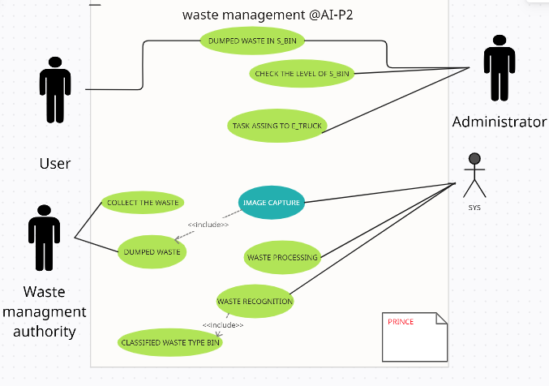
USE CASE:

Slide 10
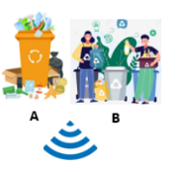
WORKING FLOW :
CLASSIFIED
WASTE
ETC..
WASTE PROCESSING
SYS PROCESSING
RECYCLABLE
DATA STORAGE
IMG CAPTURE
ALGORITHM
WASTE ITEM CLASSIFICATION
HAZARDOUS
PRE-TRAINED MODEL
ORGANIC
WASTE
WASTE
MANAGEMENT
AUTHORITIES
DUMPED
WASTE
CONTROL
UNIT
RESIDUAL
WASTE

Slide 11
ROLE AND RESPONSIBILITY OF EACH GROUP MEMBER

Slide 12
ROLE AND RESPONSIBILITY OF EACH GROUP MEMBER
PRINCE KUMAR: K21WYA02
CODING AND TRAINING THE MODULE.
AMIT GUPTA: K21WYA27
CODING AND PLANNING.
CHEERABOINA JAYARAJU : K21WYB52
RESEARCHING.

Slide 13
GANTT CHART 📊

Slide 14
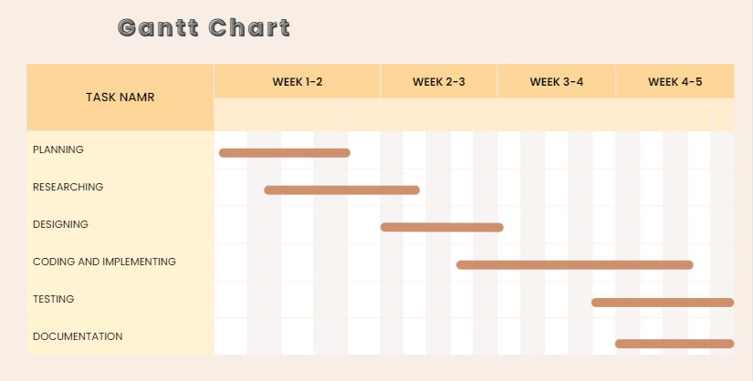

Slide 15
DATASET:
Garbage Classification | Kaggle
Waste Classification Dataset | Kaggle

Slide 16


REFERENCE:
@ CANVA

Slide 17
thank you
O_O

